Slide 1
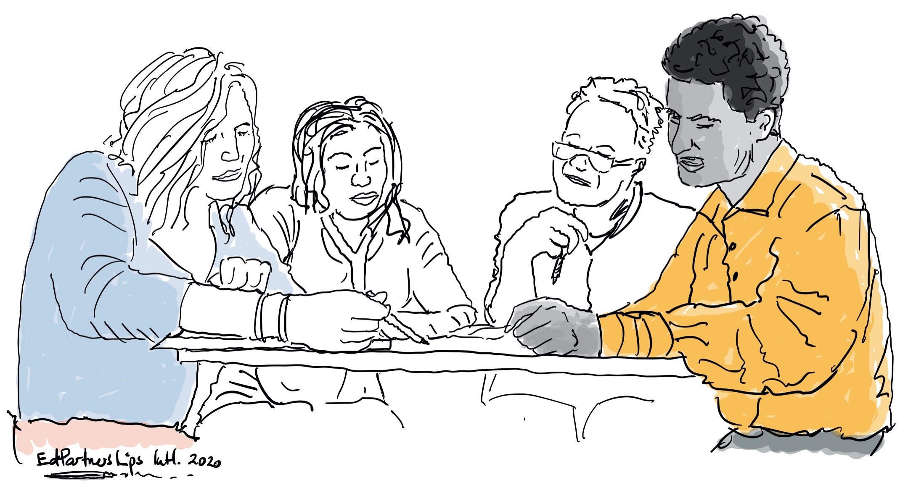
LFA 1.3 Note Taking and Discussion Scaffold
What can we learn from other school communities, the educational evidence base and system level policy and guidance?
Investigation Team Summary Version

Slide 2
Investigation Team Summary LFA 1.3 booklet
What have we learned that helps us to re-imagine more meaningful reporting (processes and products) with and for our families?
From other schools?
From the educational evidence base?
From the system level?

Slide 3
Investigation Team Summary LFA 1.3 booklet
After engaging with the ACER report and school case studies and responding individually, the team summarises their collective responses to the following prompts:
What are you now noticing tends to be privileged in your local reporting processes and documentation? Implications?
To what extent is a holistic understanding of each learner communicated through your reports and reporting processes? How might this be further strengthened?

Slide 4
Investigation Team Summary LFA 1.3 booklet
What is something from the ACER report that is worth considering in your context? Why? How might you approach this?
What further questions, wonderings or challenges have arisen in light of reading this report?

Slide 5
Investigation Team Summary LFA 1.3 booklet
After engaging with the system documents, and responding individually, the team summarises their collective responses to the following prompts:
To what extent are our current reports accessible and easy for parents and carers to understand? What might require further strengthening and how might this work be undertaken and by whom?
How might parent/carer learning partnerships be further strengthened in assessment and reporting processes?

Slide 6
Investigation Team Summary LFA 1.3 booklet
What role is available to students and their parents/carers, when engaging in parent/carer-teacher-student conferences?
What might leadership teams and teachers need to do less of and more of if conferences are to ensure greater equity of voice and perspective from all involved?
How can students take a more active role in conferences, a role that supports them in being and becoming assessment capable learner?

